Slide 1
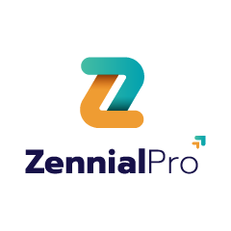

FAST API + MONGO DB
Life Link – Connecting Blood Donors to Those in Need
PRESENTED BY – P.SIVA HANUMAN RAJU

Slide 2
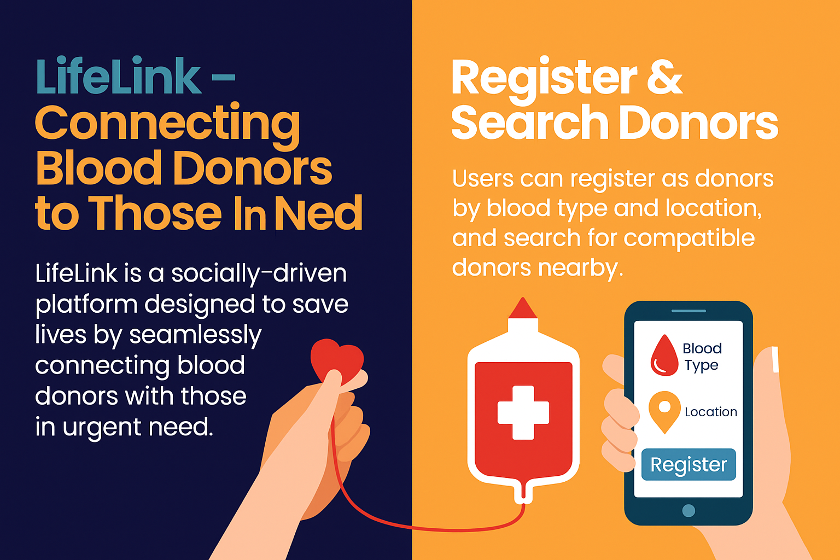

Project Overview
1.Life-Saving Platform – Designed to connect blood donors with patients in urgent need.
2.Donor Registration – Users can register with details like blood type, location, and availability
3.Search & Match – Patients can quickly find compatible donors nearby
4.Emergency Requests – Allows posting urgent blood requests visible to nearby donors.
5.Secure & Reliable – Implements JWT authentication and encrypted data protection.
6.Scalable System – Modular design for future integration with hospitals and blood banks.
8.Community Impact – Builds a responsible donor network to save more lives faster.
PPT Deck Name

Slide 3

PPT Deck Name

Slide 4
Architecture:
1.Backend API (FastAPI)
Core logic and processing layer.
Manages authentication, donor data, requests, and notifications.
Uses JWT for secure access
2.Databases (Hybrid Model)
MongoDB (NoSQL): Stores donor profiles, locations, and emergency requests.
MySQL (Relational): Manages user accounts, authentication, and reports.
3.Donor Matching Workflow
Matches blood type + location + availability.
Prioritizes urgent cases with AI-powered logic.
Returns nearest compatible donor list
PPT Deck Name

Slide 5

LifeLink – Connecting Blood Donors
Emergency Blood Requests &Faster Response Times
LifeLink is a socially-driven platform designed to save lives by seamlessly connecting blood donors with those in urgent need.
Patients and families can post urgent blood requests. The platform identifies the best donor matches based on blood type and proximity, ensuring faster response during emergencies.
Register & Search Donors
Life Link improves the speed of connecting patients with available donors, ensuring timely support and maximizing the chances of saving lives
Register & Search Donors Users can register as donors by blood type and location, and search for compatible donors nearby.
PPT Deck Name

Slide 6
Thank You

